Slide 1
Interfacing of BBB wireless with ThingSpeak on receiver side
Submitted by
Ashok Kumar Saini

Slide 2
Objectives
How to set wifi on BBBW
Learning about IoT
Learning about ThingSpeak platform
Requirement of ThingSpeak our project
Coding for interfacing BBBW with ThingSpeak

Slide 3
Hardware and Software requirement
Beaglebone Black Wireless
A PC
ThingSpeak Account

Slide 4
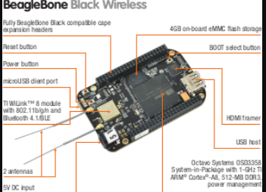

Slide 5
BBB Wireless Wifi Module
BBB wireless have onboard 802.11 b/g/n 2.4GHz WiFi and Bluetooth
The BeagleBone Black Wireless (BBBW) uses the same wireless chip as the BeagleBone Green Wireless (BBGW), which is the WL18MODGB TI module.
BBBW does not have a built-in antenna therefore solely relies on the provided external antennas.

Slide 6
Setting the wifi on BBBW board
ssh debian@192.168.7.2
sudo connmanctl
connmanctl> enable wifi
connmanctl> Services
connmanctl> agent on
connect wifi_xxxxxxxx_managed_psk
quit

Slide 7
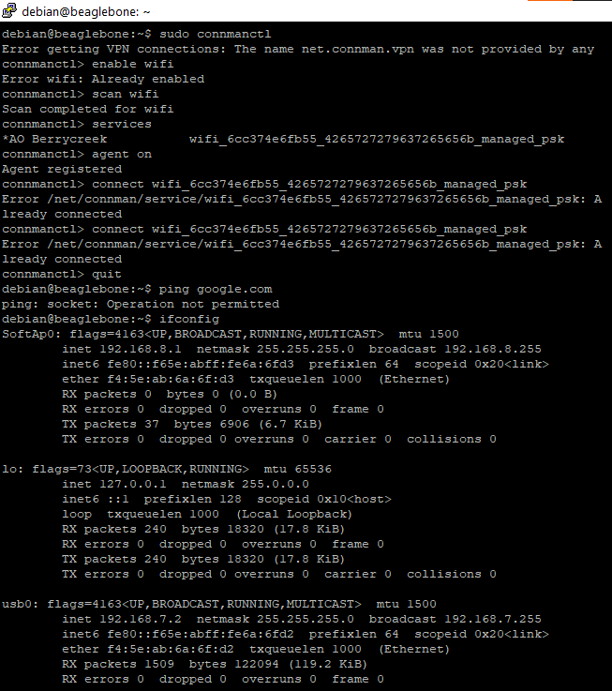

Slide 8
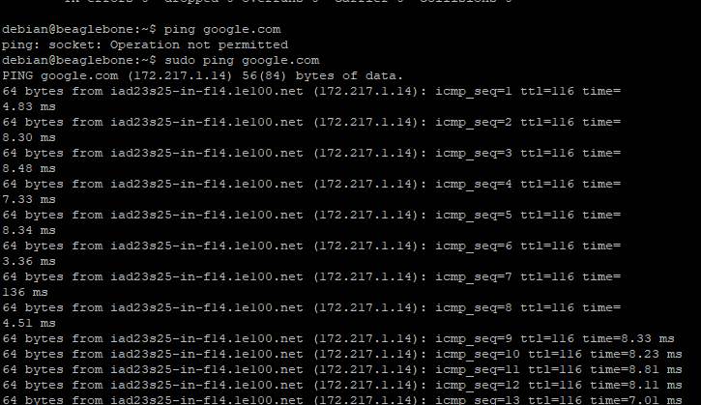

Slide 9
What is IoT?
The Internet of Things, or IoT, refers to the billions of physical devices around the world that are now connected to the internet, all collecting and sharing data.
Pretty much any physical object can be transformed into an IoT device if it can be connected to the internet to be controlled or communicate information.

Slide 10
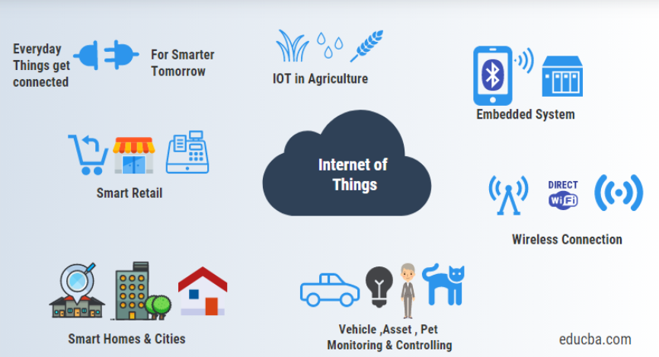

Slide 11
IoT Service Provider
Amazon Web Services
ThingSpeak
Google Cloud IoT Core.
IBM Watson IoT Platform.
Datadog.
AWS IoT Analytics.
ThingsBoard.
Thing+
Ubidots.
AT&T IoT Platform.

Slide 12

What is ThingSpeak
ThingSpeak server is an open data platform and API for the Internet of Things that enables you to collect, store, analyze, visualize, and act on data from sensors.
ThingSpeak enables sensors, instruments, and websites to send data to the cloud where it is stored in either a private or a public channel. Once data is in a ThingSpeak channel, you can analyze and visualize it, calculate new data, or interact with social media, web services, and other devices.

Slide 13

Features of ThingSpeak Channel
MATLAB Visualition and Analysis
Private View and Public View
Export and Import Data
API keys (read and write API keys)
13

Slide 14
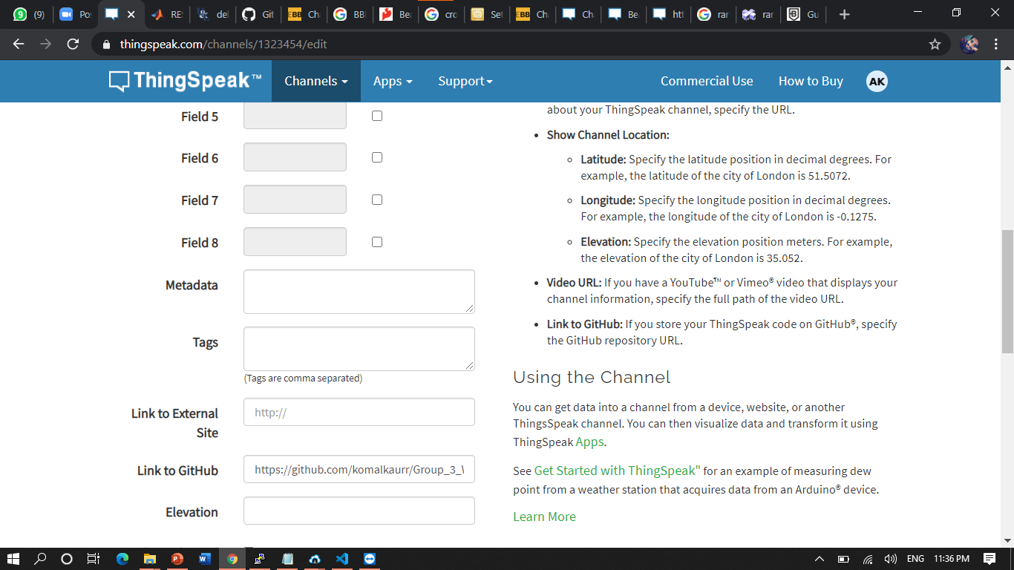

Slide 15
How to create a Channel?
Enter Channel Name
Description about channel
Number of field you want to use (Max 8)
We can enter Github link as well as external website link
Longitude and Latitude information

Slide 16
ThingSpeak Features
• All-purpose Data Storage and Retrieval
– Tweet-sized data
– Push data from devices
– Use data in apps
– Data Types:
• Sensor Data
• Text Data
• Geolocation Data
• Data Visualization
– Charts
– Maps

Slide 17
ThingSpeak Features
• Data Processing
– Min / Max Filtering
– Time scaling
– Summing
– Averaging
– Median
• Twitter Integration
– Send Tweets
– Use data collected by Twitter
– Twitter callbacks

Slide 18
ThingSpeak Features
• Integrated Web Apps
– ThingHTTP
– Low-level access to high-level web resources
– TweetControl
– Monitor twitter for keywords and react
– ThingTweet
– Send Tweets without Oauth
• Open Source API and Web App

Slide 19
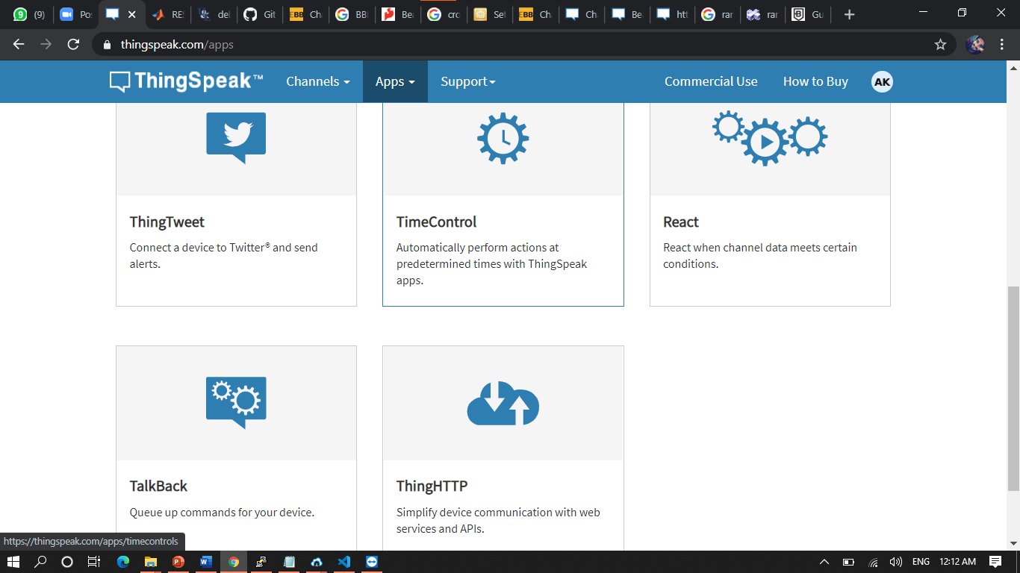

Slide 20

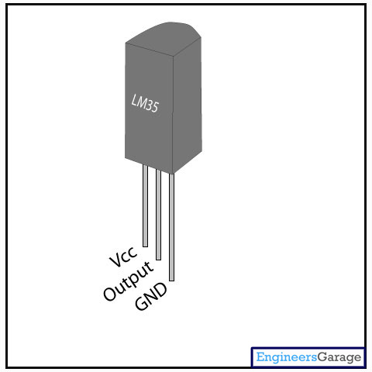

Slide 21

Connecting LM35 to BBBW
Pin
Pin 1 of (vcc) of LM35 to pin 4 of P9 header of BBBW.
Pin
Pin 2 of (analog Output) of LM35 to pin 40 of P9 header of BBBW.
Pin
Pin 3 of (GND) of Lm35 to pin 45 or 46 of P9 header of BBBW.

Slide 22
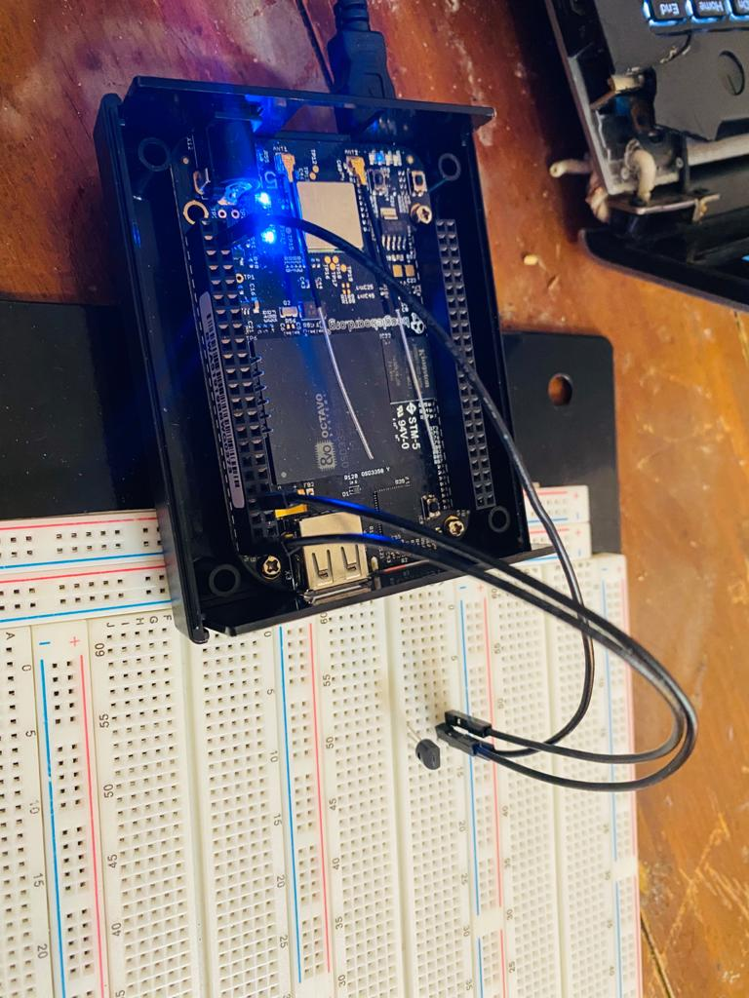

Slide 23
Calculation of Temperature
Stepsize of LM 35 is 10 mV means when 1 degree temperature changes, output voltage of sensor increases by 10 mV.
Stepsize of ADC is 0.44 mV that’s why we need to divide it by 22.75 to get the correct temperature in Celsius.
Factor value = 10 mV / 0.44 mV = 22.75 mV
Dout = (Vin * 4096) / 1800
Celsius = (Dout)/22.75

Slide 24
Main Code
#include <iostream>
#include <sstream>
#include <unistd.h>
#include <fstream>
#include "SocketClient.h"
using namespace std;
using namespace internetOfThings;
void thingSpeak(int sendData1) // thingSpeak function
{
ostringstream head, data;
cout << "Starting ThingSpeak Example" << endl;
SocketClient sc("api.thingspeak.com",80);
data << "field3=" << sendData1 << endl; // putting data in Field 3 of ThingSpeak
cout << "Check : "<<sc.connectToServer(); // connecting to thingSpeak server
}

Slide 25
Code
head << "POST /update HTTP/1.1\n"
<< "Host: api.thingspeak.com\n"
<< "Connection: close\n"
<< "X-THINGSPEAKAPIKEY: YHOLRJA0W7XREL23\n"// write API key for thingSpeak channel
<< "Content-Type: application/x-www-form-urlencoded\n"
<< "Content-Length:" << string(data.str()).length() << "\n\n";// calculating string Length
sc.send(string(head.str()));
sc.send(string(data.str())); // submittng data in string
string rec = sc.receive(1024);
cout << "[" << rec << "]" << endl;
cout << "End of ThingSpeak Example" << endl;

Slide 26
Code for Temperature Function
int getTemp() // generating a temerture function
{
float calculated_temp; // generating a local variable
fstream f; // generating a stream for file
f.open("/sys/bus/iio/devices/iio:device0/in_voltage1_raw"); // config P9_40 AIN of BBBW
f>>calculated_temp; // giving file address to local variable
calculated_temp= (calculated_temp/22.75); // formula for calculating temp in celsius
return (int)calculated_temp; //returning integer value to getTemp function
}

Slide 27
Code for Main function
int main()
{
while(1)
{
thingSpeak(getTemp()); //putting value from getTemp function to thingSpeak function
sysytm("sleep 15"); // putting system to sleep for 15 sec
}
return 0;
}

Slide 28
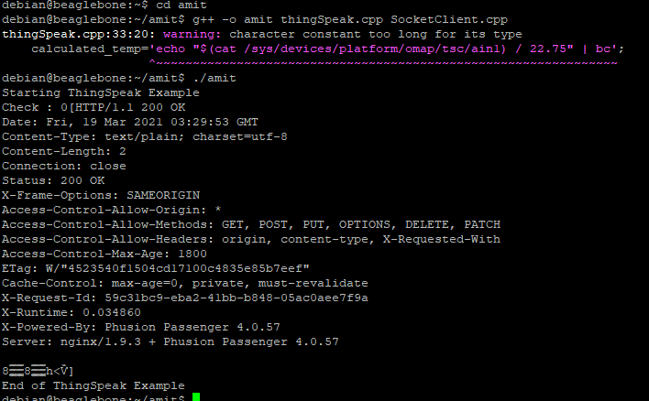

Slide 29
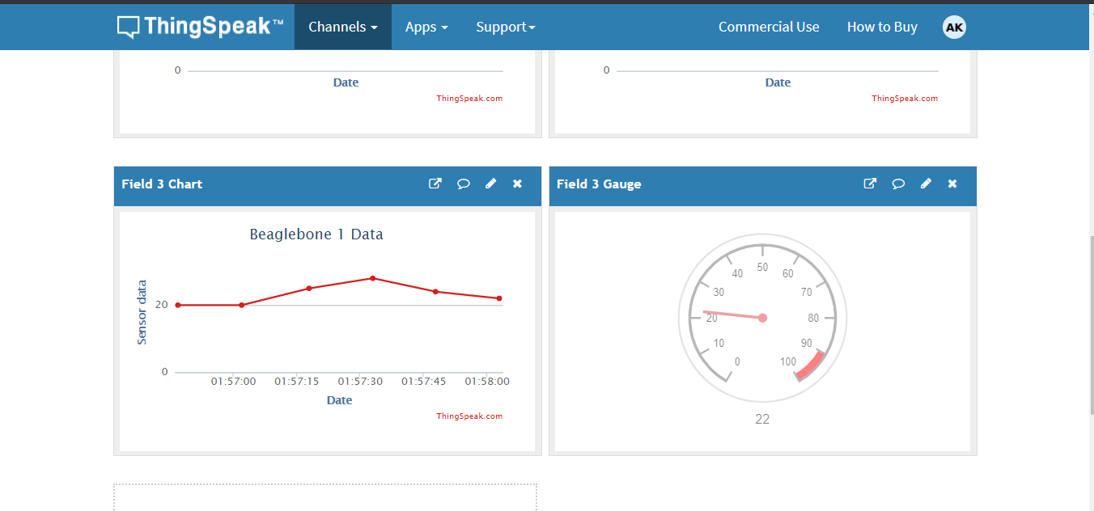

Slide 30
References
Setting up wifi on BBBW
https://www.fis.gatech.edu/how-to-configure-bbw-wifi/
BBBW information
https://www.google.com/search?q=On+board+information+about+wifi+module+on+BBB+wireless&rlz=1C1OPNX_enCA942CA942&sxsrf=ALeKk00Cg2-ZiPdnEi3jFFBwEDaNbriUIg:1615846767775&source=lnms&tbm=isch&biw=1199&bih=577#imgrc=V1KaLbD9-9yHXM
ThingSpeak Information
https://thingspeak.com/channels/new

Slide 31
References
LM35 data on thingSpeak
https://electronics-project-hub.com/send-lm35-data-to-thingspeak-esp8266-gsm-nodemcu/
https://www.engineersgarage.com/electronic-projects/measure-temperature-using-lm35-interfacing-with-beaglebone-black-part-15-15/
https://electronics.stackexchange.com/questions/105550/temperature-measurement-using-lm35

Slide 32

Questions? Thank You

